Slide 1

ATTENDANCE CHECKMARK
Attendance Counts
Be Here !!
Every Day, All Time
AMITY UNIVERSITY PATNA

Slide 2
INTRODUCTION :
Attendance Checkmark allows us to record and manage daily student attendance to speed up the daily attendance process. Student attendance system helps teachers to mark online attendance of students during class and reduces manual work.
OBJECTIVE :
Our project has following objective :
1. It reduces admin work by integrating the details of students of all the departments into single database.
2. Manual work for information retrieval on attendance becomes less as the work becomes digitalized.
By this chances of error are also reduced.
4. It will eliminate chances of duplicate data entry in time and attendance entries.
5. It is time saving and also gives an easy access for students as well as teachers (admin) .

Slide 3
REQUIREMENTS :
The online attendance app is simple but requires us to know the following :
1. Android studio and its SDK tools Knowledge.
2. Android Activity and Activity lifecycle.
3. XML and Layout Designing.
4. Android UI elements.
Java and Object – Oriented Programming.
SQLite database

Slide 4
DESCRIPTION
This project is about marking online attendance of students of any institution.
It includes following modules :
SPLASH SCREEN
LOGIN SCREEN
MENU SCREEN
ATTENDANCE PORTAL
Attendance Checkmark project allows us to record manage daily student attendance to speed up the daily attendance process. It can be used to track student’s attendance, absent record, attendance history , download records and other related documents. This enables institutions to compile daily data and enables faculties to generate 100 % accurate attendance reports.

Slide 5

SPLASH SCREEN
This screen gives the first glimpse of our application.

Slide 6
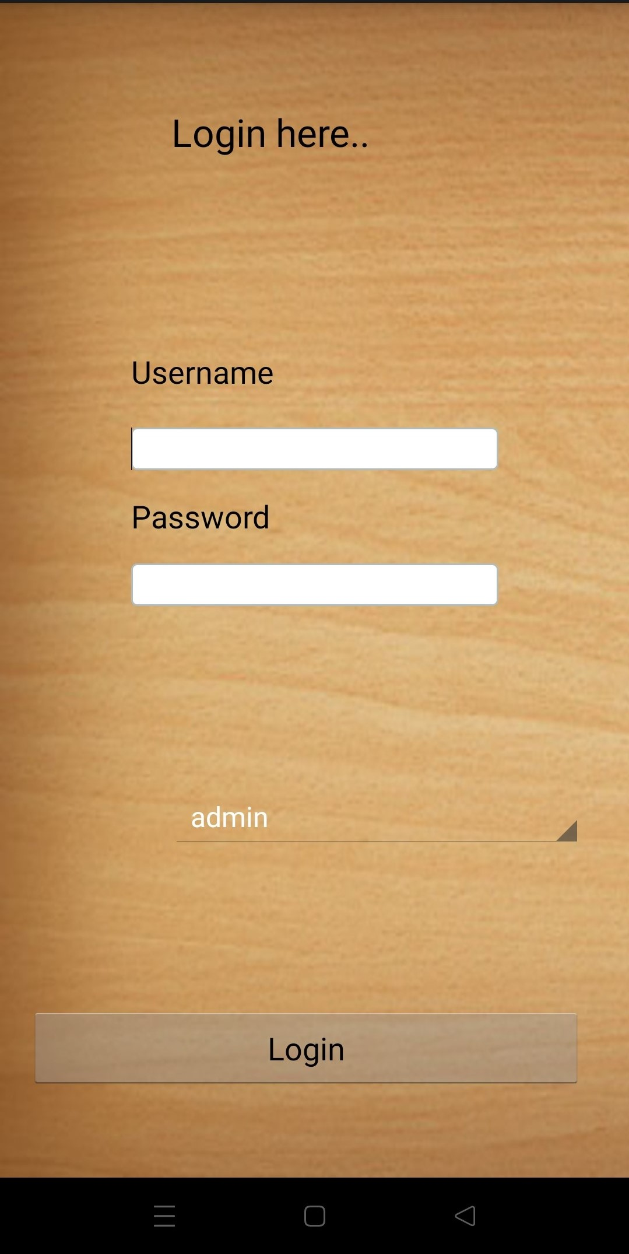

LOGIN SCREEN
This is the login screen of our Attendance Checkmark application . There are two login options in this app . First option is admin login and second is faculty login.

Slide 7
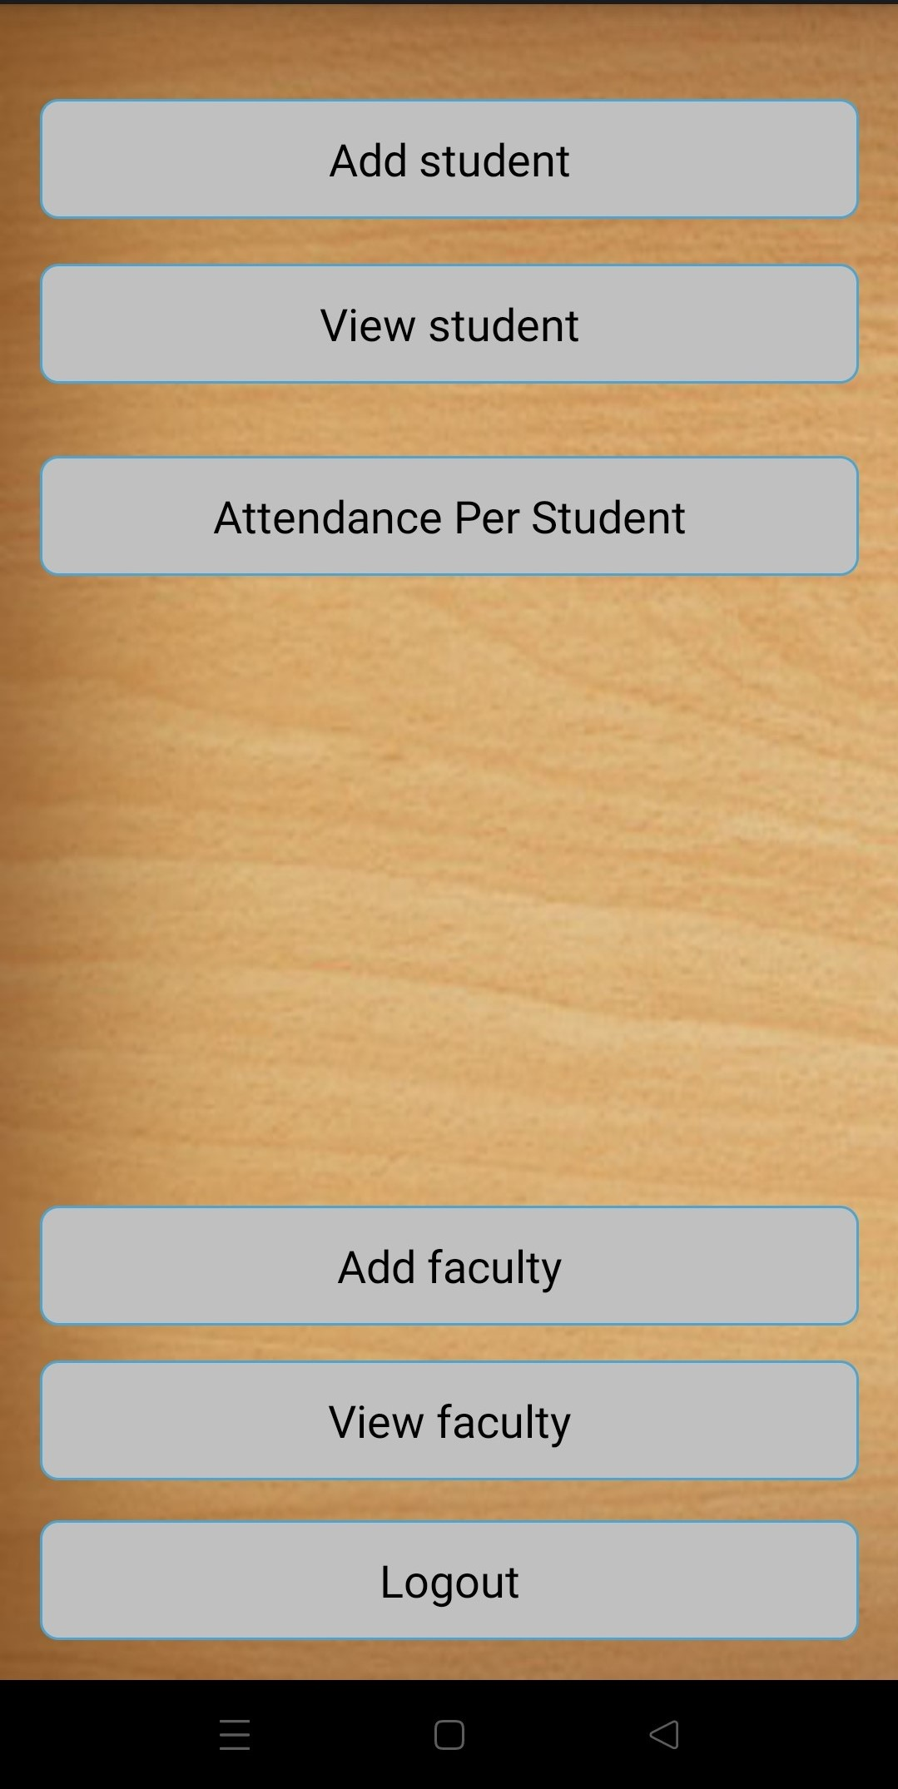
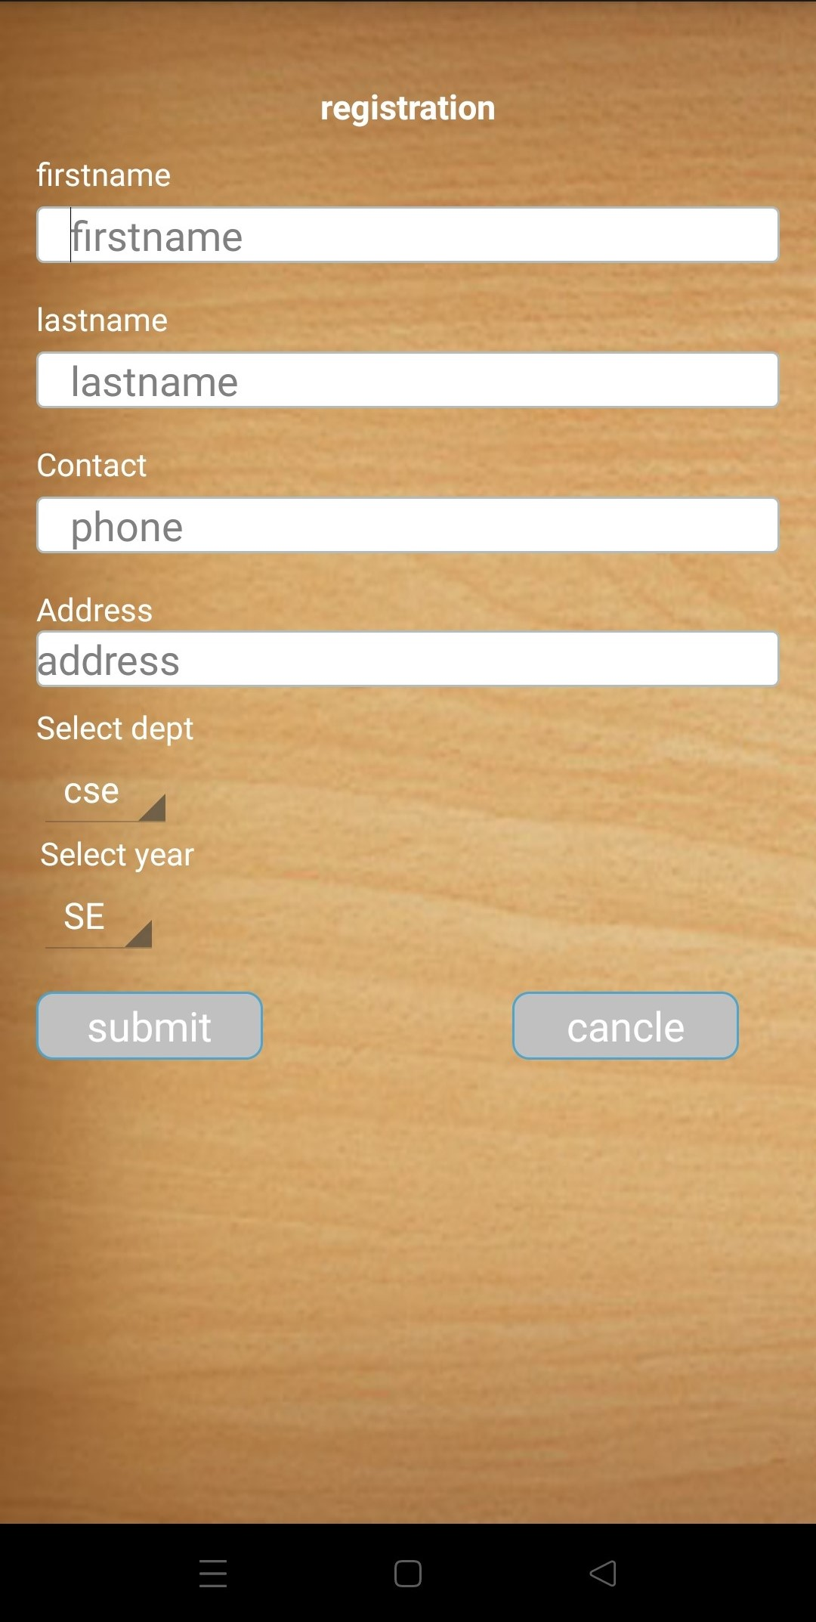
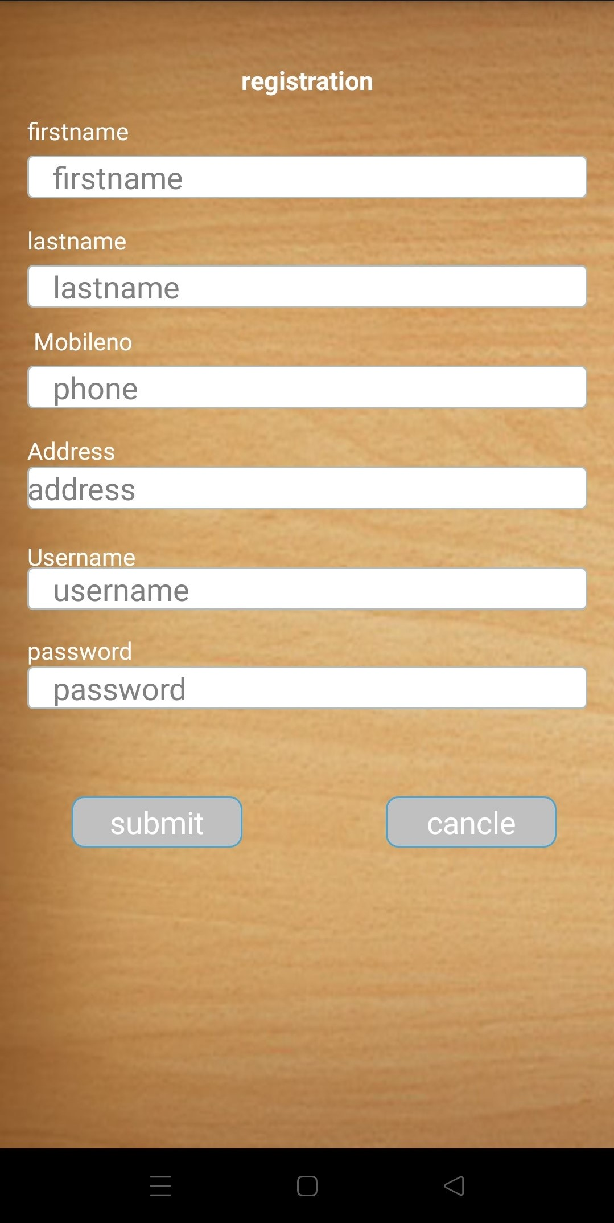
NEXT MODULE (Menu Screen) :
This module contains the options of adding a student(new registration) , adding a faculty , viewing a student and taking attendance per student.

Slide 8
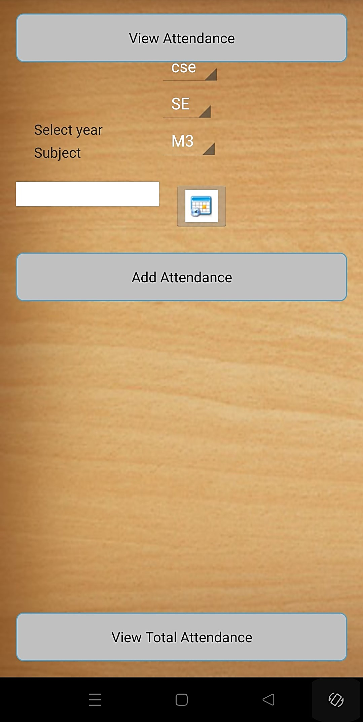
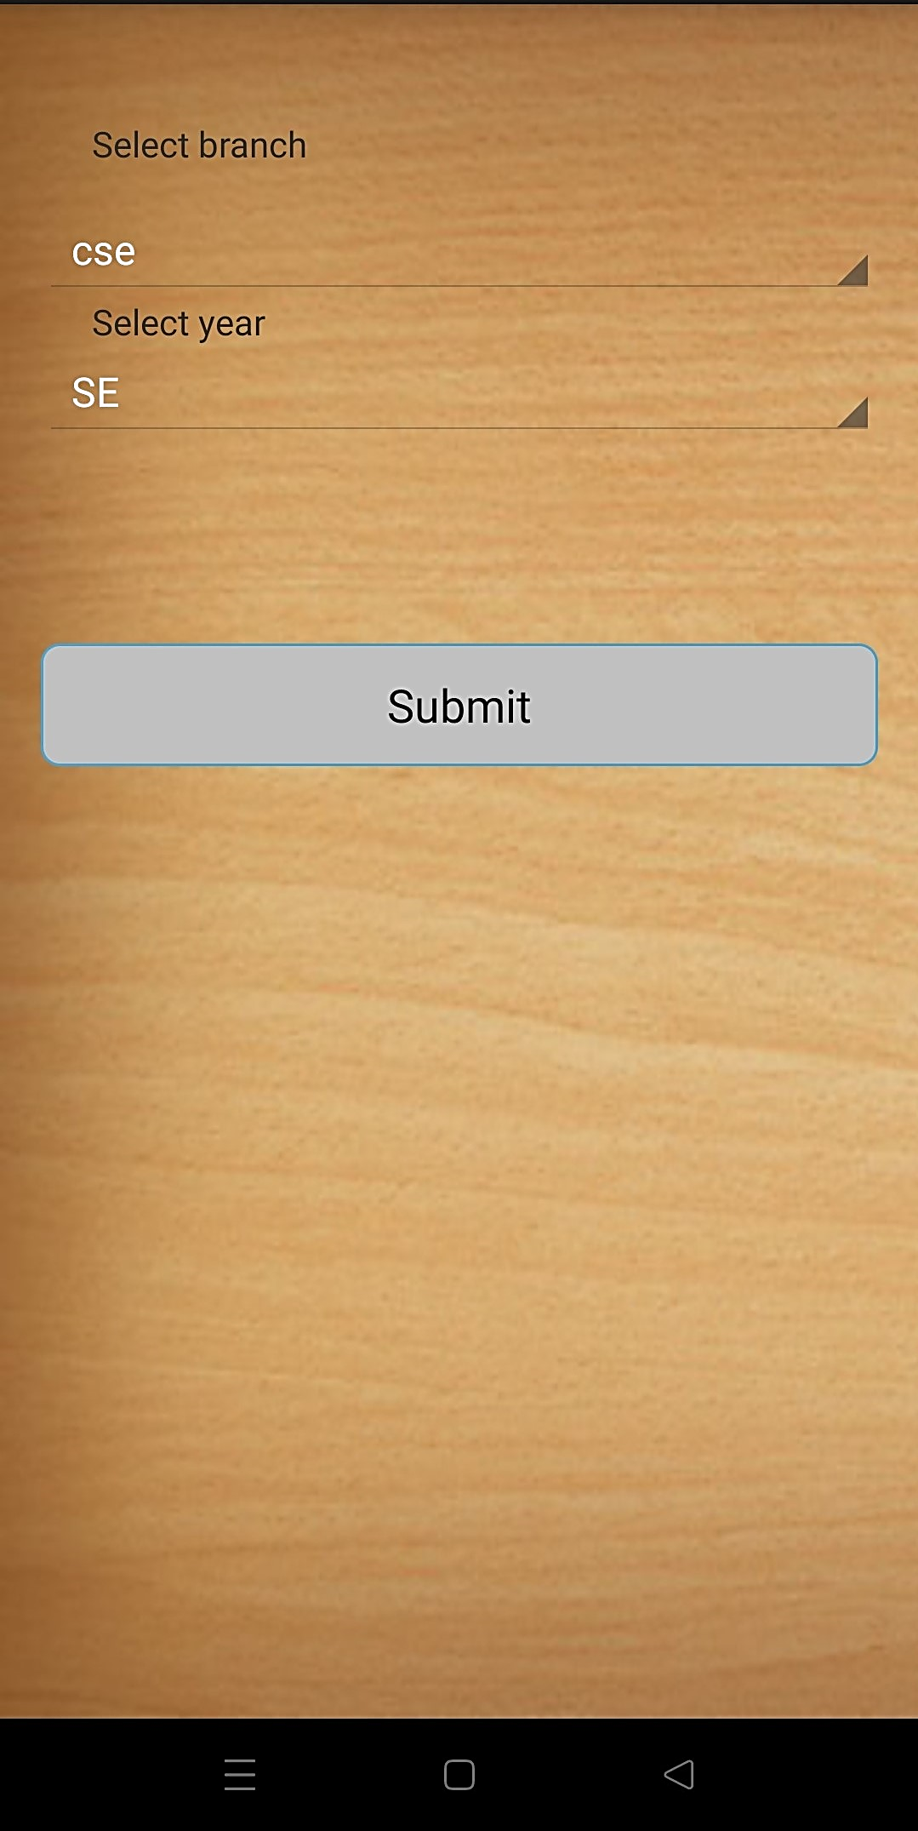
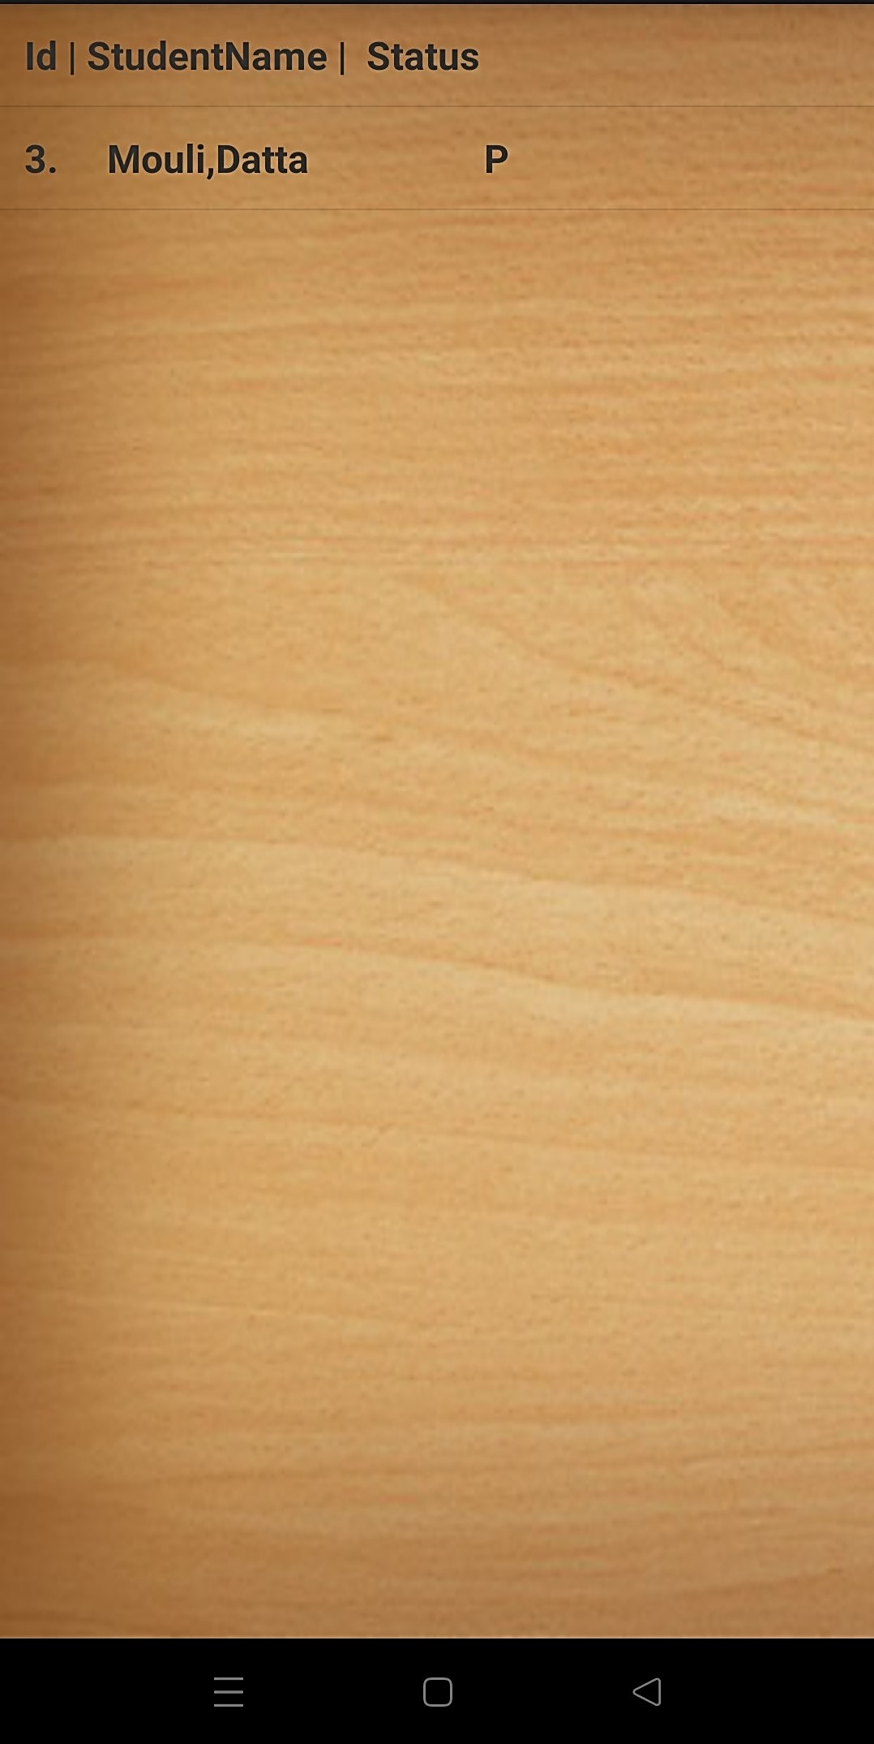
LAST MODULE (Attendance Portal) :
This module is about attendance per student . First of all Semester can be selected then according to that attendance of each added student can be marked.

Slide 9
CONCLUSION :
In a nutshell, this application will save time, reduce the amount of work the administration to do and will replace stationary material with digital systems. This app will be a reliable , secure and fast system for managing such attendance databases.
UNDER GUIDANCE OF MANI GAUTAM SIR
Delivered by :
Mouli Datta
Aishwarya Soni
Bhawna Kumari
Arti Verma

